Slide 1



International Debt Statistics - BI
View in Power BI
Business Analytics
Visualized by - Kamalesh Selvaraj
- Shreya Bodla
Technique used : Microsoft PowerBI

Slide 2
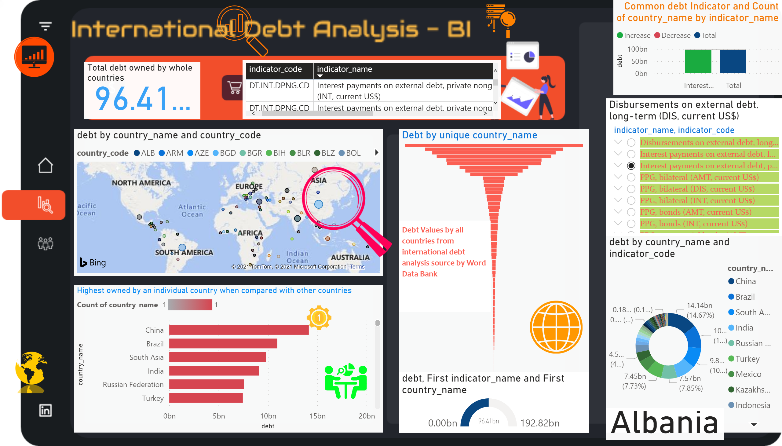
Page 1
Notes:
Highest owned by an individual country when compared with other countries
No alt text provided.
map
No alt text provided.
Common debt Indicator and Count of country_name by indicator_name
No alt text provided.
Total debt owned by whole countries
No alt text provided.
tableEx
No alt text provided.
Debt by unique country_name
No alt text provided.
Disbursements on external debt, long-term (DIS, current US$)
No alt text provided.
donutChart
No alt text provided.
textbox
No alt text provided.
gauge
No alt text provided.
image
No alt text provided.
image
No alt text provided.
image
No alt text provided.
image
No alt text provided.
image
No alt text provided.
image
No alt text provided.
image
No alt text provided.
image
No alt text provided.
image
No alt text provided.
card
No alt text provided.

